Slide 1

Profitability Ratios

Slide 2
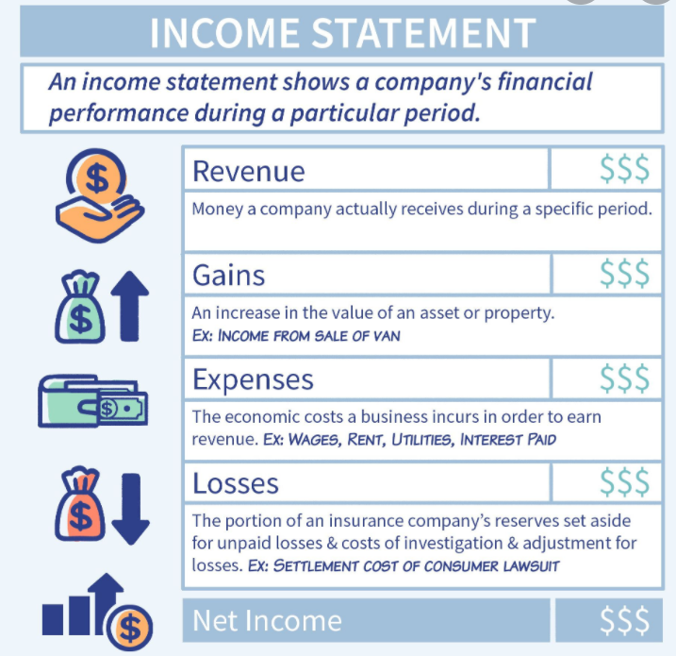
Profitability Ratios
These ratios take into account the financial information provided in the Income Statement.
Evaluating profitability
One of the main reasons for a business to
prepare an Income Statement is to see what
the profit and loss figure is for the period.
This is the start of evaluating the true
performance of the business.

Slide 3

Profitability:
The earning capacity of a business during the accounting period. If a business is profitable then it is generating a reasonable return.
Measures of Profitablity:
Gross profit ratio
Profit ratio
Expense ratio
Return on assets

Slide 4
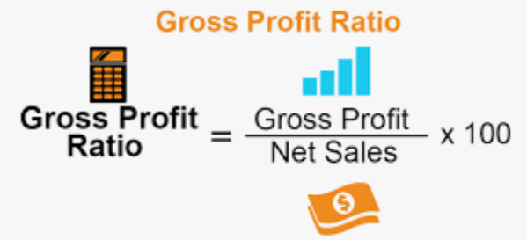
Gross Profit Ratio
This is a measure of percentage of each dollar of sales that results in profit.
This ratio should be compared to previous periods or industry averages.

Slide 5

Gross Profit Ratio
If the ratio is INCREASING:
Inventory may have decreased eg lower
freight costs or customs duty.
The selling price of inventory may have risen,
greater to any increase in the cost of inventory.

Slide 6

Gross Profit Ratio
If the ratio is DECREASING:
Inventory may have increased eg. higher freight costs.
The selling price of inventory may have decreased.

Slide 7

Gross Profit Ratio
Consider the information for DA Surf Retailer:
 | 2020
Net Sales | $75,000
Gross Profit | $50,000
Gross Profit ratio= | 50,000
 | 75,000
 | = 0.67:1
 | = 66.7%
Analyse this data.

Slide 8
Gross Profit Ratio
Consider the information for DA Surf Retailer :
 | 2020
Net Sales | $75,000
Gross profit | $50,000
Gross Profit ratio= | 50,000
 | 75,000
 | = 0.67:1
 | = 66.7%
For every $1 earned,
67c is gross profit.
Is this good or bad?

Slide 9
Gross Profit Ratio
Consider the information for DA Surf Retailer:
 | 2020
Net Sales | $75,000
Gross Profit | $50,000
Gross Profit Ratio = | 50,000
 | 75,000
 | = 0.67:1
 | = 66.7%
For every $1 earned,
67c is profit.
Is this good or bad?
To determine this we would need to compare with previous years or other businesses in the same industry.

Slide 10
Questions:
1. Compare and contrast the words profit and profitability.
2. Why would a business compare their business results with industry averages, budgeted amounts and results from previous periods?
3. What is an ideal result for the gross profit ratio?
4. What does an increase in profitability ratios indicate?
5. What does a descrease in profitability ratios indicate?

Slide 11
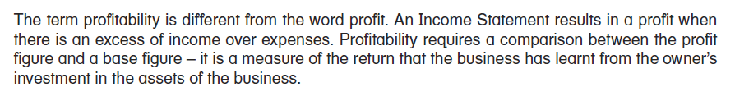
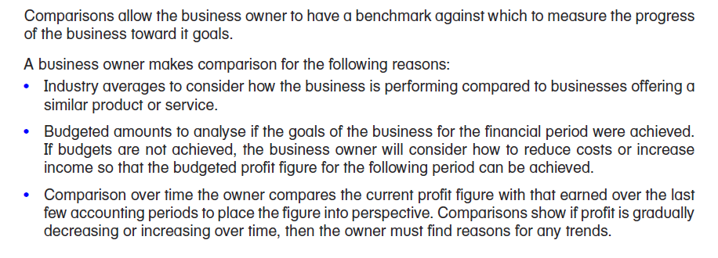
Compare and contrast the words profit and profitability.
2. Why would a business compare their business results with industry averages, budgeted amounts and results from previous periods?

Slide 12
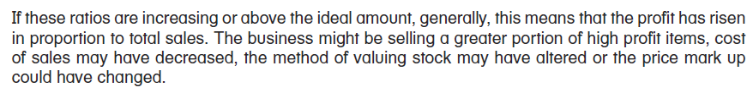
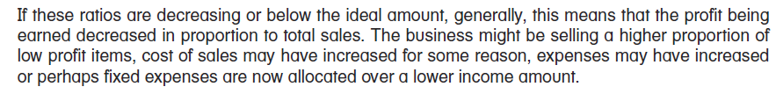
3. What is an ideal result for the gross profit ratio?
4. What does an increase in profitability ratios indicate?
5. What does a descrease in profitability ratios indicate?

Slide 13

Profit Ratio
The profit ratio doesn’t separate out a specific part of Income Statement information, rather it compares the total profit to sales, calculating the profit earned from each dollar of sales.
A positive ratio = profit
A negative ratio = loss
Profit Ratio = | Profit | x | 100
 | Net Sales |  | 1

Slide 14
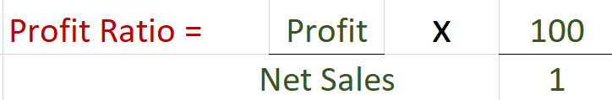
Profit Ratio
If the ratio is INCREASING:
Expenses may have decreased.
Cost of Sales may have decreased.
- The Gross Profit Ratio may have increased.

Slide 15
Profit Ratio
If the ratio is DECREASING:
Expenses may have increased.
Cost of Sales may have increased.
- The Gross Profit Ratio may have decreased.

Slide 16
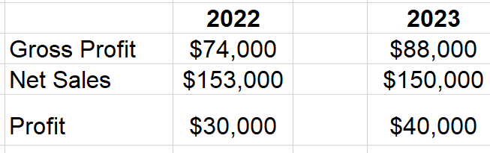
Profit Ratio
The profit ratio for DA Surf Retailer:
Calculate the profit ratio.

Slide 17
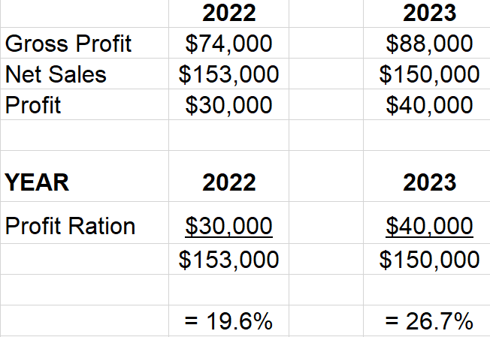
Profit Ratio
The profit ratio for DA Surf Retailer:
Analyse this data.

Slide 18
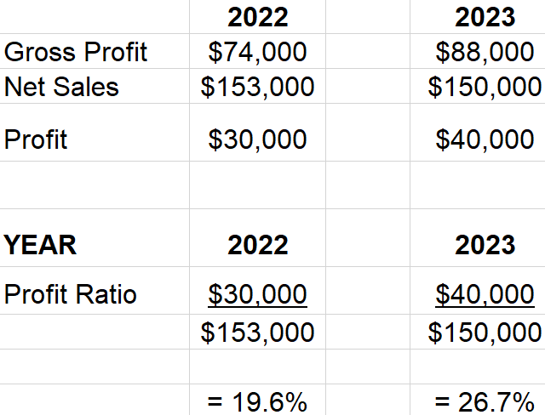
Profit Ratio
The profit ratio for DA Surf Retailer:
This shows an improvement in the business, it is earning proportionally more profits compared to sales over the two years. The ratio increased from 19.6% to 26.7%.

Slide 19
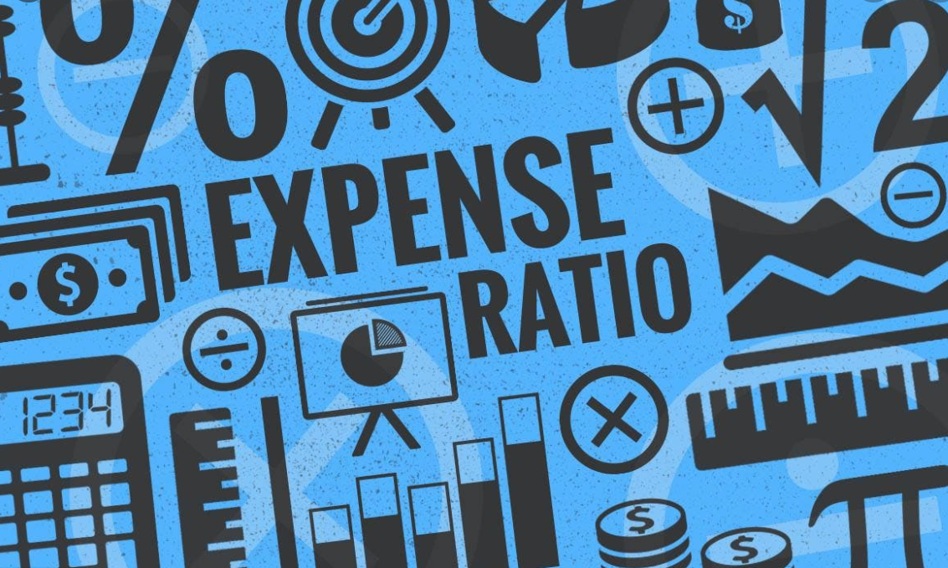
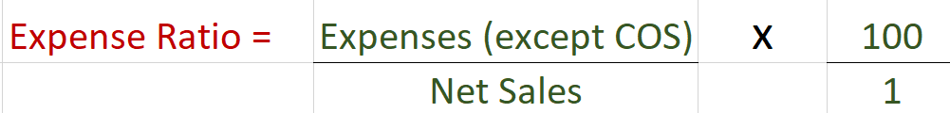
Expense Ratio
The expense ratio compares all of the expenses (except cost of sales) with net sales.
There will never be a negative expense ratio. Ideally they should be low ratios.

Slide 20
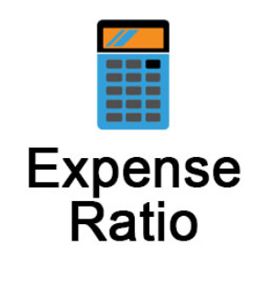
Expense Ratio
If the ratio is INCREASING:
Usually expenses have increased.
There may be an extraordinary/unusual expense incurred.
If the ratio is DECREASING:
Usually expenses have decreased.

Slide 21

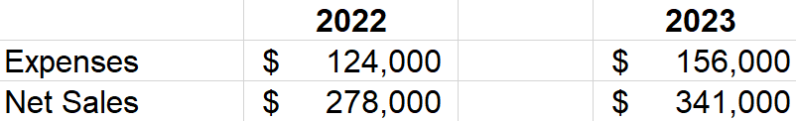
Expense Ratio
Information provided by Top Hat Pty Ltd:
Calculate the expense ratio.

Slide 22
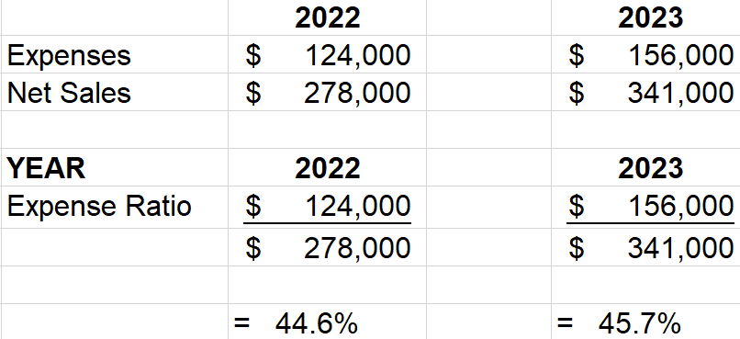
Expense Ratio
Information provided by Top Hat Pty Ltd:
Analyse the data.

Slide 23
Expense Ratio
Information provided by Top Hat Pty Ltd:
The expense ratio has remained relatively unchanged. However, the net sales have increased. The corresponding increase in expenses should be investigated.

Slide 24
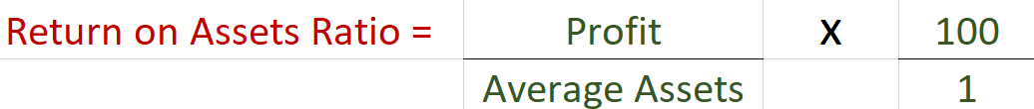

Return on Assets Ratio
This ratio indicates how efficiently the business is using its assets to generate profit.
A positive ratio = profit
A negative ratio = loss

